Slide 1
PHISHING WEBSITE DETECTION
Presented by:
Rahul Deb Majumder (MWC2022010)
Project Under Guidance of
Prof. Vrijendra Singh

Slide 2
INTRODUCTION
• Phishing is the most commonly used social engineering and cyber attack.
• Through such attacks, the phisher targets naïve online users by tricking them into revealing confidential information, with the purpose of using it fraudulently.
• In order to avoid getting phished,
Users should have awareness of phishing websites.
Have a blacklist of phishing websites which requires the knowledge of website being detected as phishing.
Detect them in their early appearance, using machine learning and deep learning algorithms.
• Of the above three, the machine learning based method is proven to be most effective than the other methods.
• Even then, online users are still being trapped into revealing sensitive information in phishing websites.

Slide 3
OBJECTIVES
A phishing website is a fraudulent website that is designed to look like a legitimate website in order to trick users into divulging sensitive information.The objective of this project is to train machine learning models and deep neural nets on the dataset created to predict phishing websites. Both phishing and benign URLs of websites are gathered to form a dataset and from them required URL and website content-based features are extracted. The performance level of each model is measures and compared.

Slide 4
APPROACH
Below mentioned are the steps involved in the completion of this project:
• Collect dataset containing phishing and legitimate websites from the open source platforms.
• Write a code to extract the required features from the URL database.
• Analyze and preprocess the dataset by using EDA techniques.
• Divide the dataset into training and testing sets.
• Run selected machine learning and deep neural network algorithms like SVM, Random Forest on the dataset.
• Write a code for displaying the evaluation result considering accuracy metrics.
• Compare the obtained results for trained models and specify which is better.

Slide 5
DATA COLLECTION
• Legitimate URLs are collected from the dataset provided by University of New Brunswick, https://www.unb.ca/cic/datasets/url-2016.html.
• From the collection, 5000 URLs are randomly picked.
• Phishing URLs are collected from open source service called PhishTank . This service provide a set of phishing URLs in multiple formats like csv, json etc. that gets updated hourly.
• Form the obtained collection, 5000 URLs are randomly picked.

Slide 6
FEATURE SELECTION
• The following category of features are selected:
Address Bar based Features
Domain based Features
HTML & Javascript based Feature
Address Bar based Features considered are:
Domain of URL
Redirection ‘//’ in URL
IP Address in URL
‘http/https’ in Domain name
‘@’ Symbol in URL
Using URL Shortening Service
Length of URL
Depth of URL
Prefix or Suffix "-" in Domain

Slide 7
FEATURE SELECTION (CONT.)
• Domain based Features considered are:
DNS Record
Age of Domain
Website Traffic
End Period of Domain
• HTML and JavaScript based Features considered are:
Iframe Redirection
Disabling Right Click
Status Bar Customization
Website Forwarding
• All together 17 features are extracted from the dataset.

Slide 8
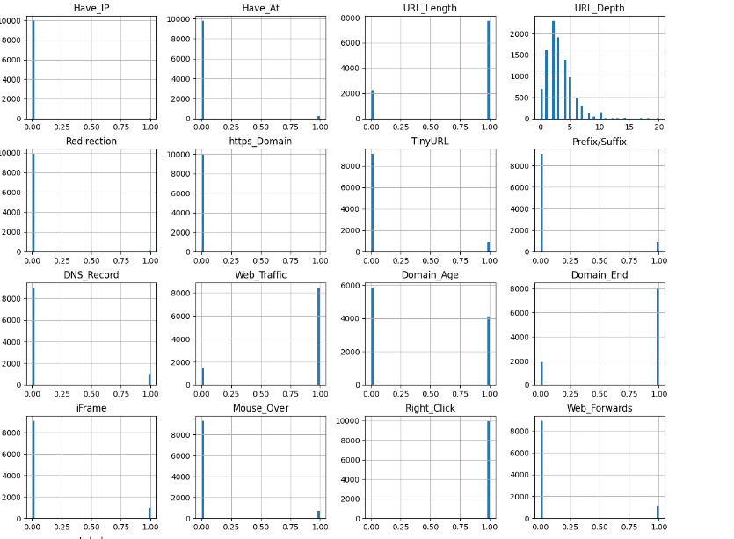
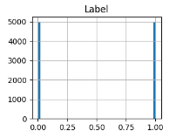
FEATURES DISTRIBUTION

Slide 9
MACHINE LEARNING MODELS
• This data set comes under classification problem, as the input URL is classified as phishing (1) or legitimate (0). The machine learning models (classification) considered to train the dataset in this notebook are:
Decision Tree
Random Forest
Multilayer Perceptrons
XGBoost
Autoencoder Neural Network
Support Vector Machines

Slide 10
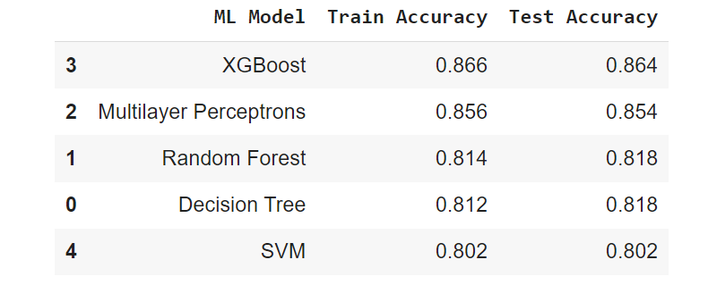
MODEL EVALUATION
• The models are evaluated, and the considered metric is accuracy.
• Below Figure shows the training and test dataset accuracy by the respective models:
• For the above it is clear that the XGBoost model gives better performance.

Slide 11
FURTHER EXPERIMENTATION
I am working on total of 3 datasets.
And need to read some research papers for further improvement.
Already started working on BPE,NLP,GAN models.

Slide 12
REFERENCES
1. Yidong Chai , Yonghang Zhou, Weifeng Li , and Yuanchun Jiang,”An Explainable Multi-Modal Hierarchical Attention Model for Developing Phishing Threat Intelligence” 2022
2.M. A. Adebowale, K. T. Lwin, and M. A. Hossain, “Deep learning with convolutional neural network and long short-term memory for phishing detection,” in Proc. 13th Int. Conf. Softw. Knowl. Inf. Manage. Appl., 2020.
3. P. Yang, G. Zhao, and P. Zeng, “Phishing website detection based on multidimensional features driven by deep learning,” IEEE Access, vol. 7, pp. 15196–15209, 2019.
4.Fishing_out_the_Phishing_Websites, Mina Jain , 2021
5.Semi-supervised Conditional GAN for Simultaneous Generation and Detection of Phishing URLs: A Game theoretic Perspective Sharif Amit Kamran, Shamik Sengupta† and Alireza Tavakkoli,2022

Slide 13
Thank You !

